Slide 1
3D Image Segmentation and Quantification of Lysosomes
19/2/2025

Slide 2
AXONS

Slide 3
GUI
New parameters in Advanced Settings:
  Coseno minimum
  Intensity minimum fraction
  Local Threshold
    Threshold block size
    Threshold offset std multiplier

Slide 4
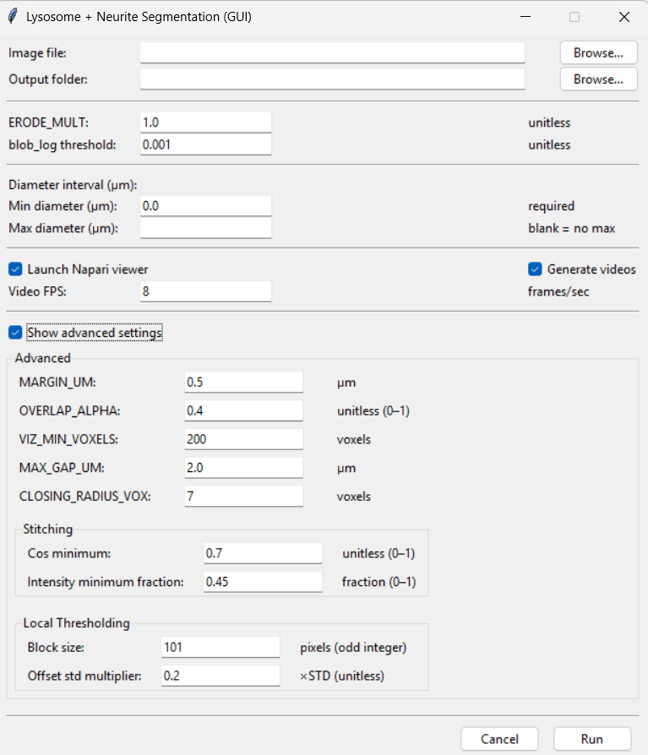
GUI

Slide 5
Coseno minimum
Are the two pieces pointing toward each other?
Imagine two broken sticks on a table then:
If both sticks are pointing at each other → it makes sense to connect them.
If one stick is pointing sideways → connecting them would look unnatural.
What it actually measures?
It compares: direction of neurite A, direction of neurite B and direction of the line between them.
It calculates a value between:
cos min = 0 (90° angle) cos min = +1 (perfectly aligned)
This value is called the cosine of the angle.
What cos_min does?
Only connect fragments if their alignment is at least this good.

Slide 6
Coseno minimum
cos_min | value | What is it mean?
HIGH | 0.6-0.8 | -Only connect pieces that are very well aligned. -Very safe. -May miss curved branches. “Only connect if they are almost in a straight line.”
LOW | 0.2-0.3 | -Connect curved or bending neurites. -Helps fragmented branches. -Risk of connecting wrong things. “Even if they bend a bit, it’s fine.”
cos_min | What is it mean?
0.7 | Almost perfectly straight
0.4 | Some bending allowed
0.2 | Quite flexible
0 | Anything goes

Slide 7
Intensity minimum fraction
Is the path between them bright enough?
Now imagine drawing a line between two broken neurite ends.
That line passes through some pixels.
This parameter asks:
“Are most of those pixels bright like neurites?”
What it actually measures?
It checks: Fraction of pixels along the bridge path that are bright enough.
What intensity_min_frac does?
It says: “Only connect if at least X% of the path looks like real neurite signal.”

Slide 8
Intensity minimum fraction
intensity_min_frac | value | What is it mean?
HIGH | 0.7-0.8 | - Only connect through bright regions. -Very safe. - May fail if neurites are dim. “The path must look very clearly like neurite.”
LOW | 0.4-0.5 | - Works for faint neurites. - Bridges gaps in low signal. - May connect through noisy background. “It’s okay if only half the path looks bright.”

Slide 9
Intensity_min_fract and cos_min
The Big Difference Between Them
How They Work Together?
Connection is allowed only if:
✔ The pieces are pointing toward each other (cos_min)
✔ The path between them looks bright enough (intensity_min_frac)
So you get: Geometric check + Intensity check
Parameter | Checks WHAT?
cos_min | Geometry (shape & direction) | One checks structure alignment
intensity_min_frac | Signal (brightness along path) | One checks image intensity quality

Slide 10
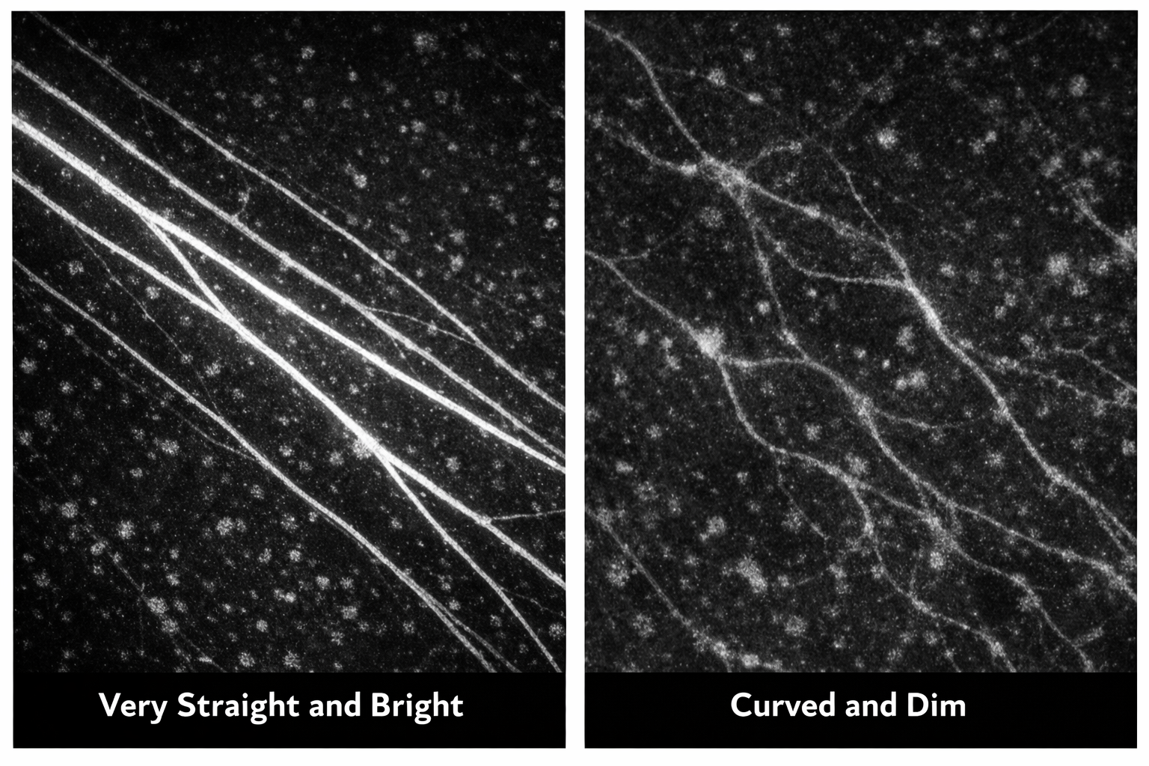
Intensity_min_fract and cos_min
Examples
 | COS_MIN | INTESITY_MIN_FRACT
Very straight and bright | 0.5–0.6 | 0.7
Curved and dim | 0.2–0.3 | 0.4–0.5

Slide 11
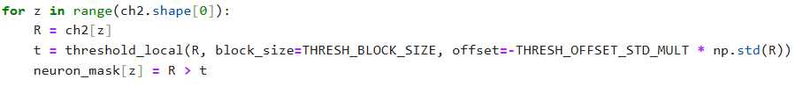
Local Threshold
The parameters:
Threshold block size
Threshold offset std multiplier
They control how the neurite mask is created from the CH2 image.
So they determine:
Which pixels become neurite (white) and which become background (black)

Slide 12
Threshold block size
How big is the neighborhood we look at?
Imagine you are deciding:Is this pixel part of a neurite?
Instead of comparing it to the whole image, you compare it only to pixels around it. How big that local neighborhood is.
Example: block_size = 3->Each pixel is compared to the average of a 3 × 3 square around it.
9
8
8
FOREGROUND (NEURITES)
10
10
5
BACKGROUND (NOT NEURITES)
3
1
2

Slide 13
Threshold block size
SIZE | VALUE | DESCRIPTION | MEANING
BIG | 201-301 | Threshold changes slowly across image. Good for smooth illumination. Good for thick neurites. May miss very thin branches. Can create small gaps in thin areas. In simply words: “You judge brightness compared to a large region.” | Smooth, conservative mask
SMALL | 51-91 | Detects thin neurites better. Adapts quickly to local changes. More sensitive to noise. Mask may look patchy. In simply words: “You judge brightness compared to a tiny neighborhood.” | Sensitive, detailed mask

Slide 14
Threshold offset std multiplier
How strict are we?
This controls how much we lower the threshold so this value decides how easy it is for a pixel to be considered neurite.
SIZE | VALUE | DESCRIPTION
BIG | 0.20–0.30 | -Dim neurites kept. -Fewer gaps -More noise included In simply words: “Even slightly bright pixels are allowed.”
SMALL | 0.05–0.10 | -Strict -Only bright neurites kept -Dim neurites may disappear In simply words: “Only clearly bright pixels count.”

Slide 15
Threshold block size and Threshold offset std multiplier
Comparison
 | What it controls
block_size | How LOCAL the decision is
offset_std_mult | How STRICT the decision is
Situation | COMBINATIONS
Thick bright axons | 151–201 + 0.12–0.15
Thin dim neurites | 91–151 + 0.18–0.22
Very noisy image | 201 + 0.08–0.12
Highly fragmented mask | 101 + 0.18–0.22
How They Work Together
Large block + small offset: Very conservative mask → possible broken branches
Small block + large offset: Very permissive mask → noise
block_size = “How big is the area I compare each pixel to?”
offset_std_mult = “How easy do I allow pixels to pass the threshold?”
If you see broken branches
→ Increase offset
→ Or decrease block_size
If you see too much noise
→ Decrease offset
→ Or increase block_size
You want | Do this
More continuity | Increase offset
Less noise | Decrease offset
More sensitivity | Decrease block size
More smooth mask | Increase block size

Slide 16
VIEWER LAYERS
Add new layers to filter per cells ID and lysosomes ID.

Slide 17
FILES:
-Airy scan_40A_UAS-TMEM-HA_axon_0h_again_2_051222
-Airy scan_40A_UAS-TMEM-HA_axon_0h_again_3_051222

Slide 18
0H 2
Erosion = 4
Thresholding = 0.002
margin um = 0.5
overlap alpha = 0.4
viz min voxels = 2000
CLOSING = 6
max_gap_UM = 4

Slide 19
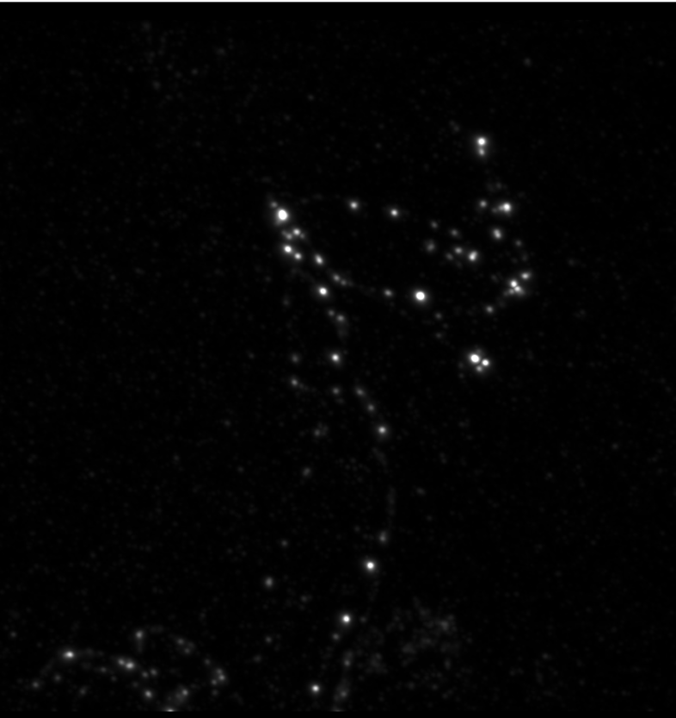
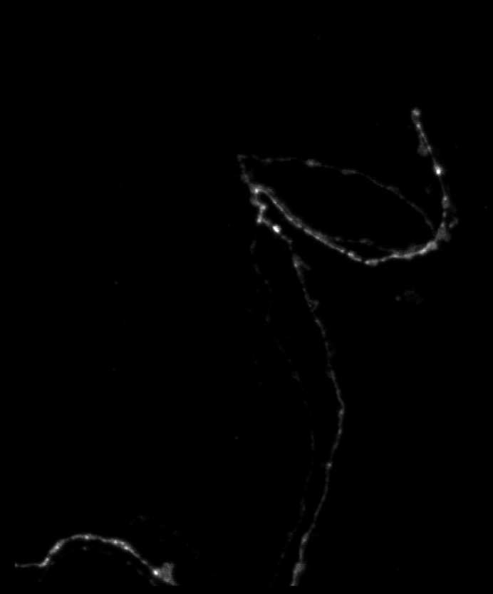
0H 2

Slide 20
0H 3
Erosion = 4
Thresholding = 0.001
margin um = 0.5
overlap alpha = 0.4
viz min voxels = 2000
CLOSING = 9
max_gap_UM = 3

Slide 21
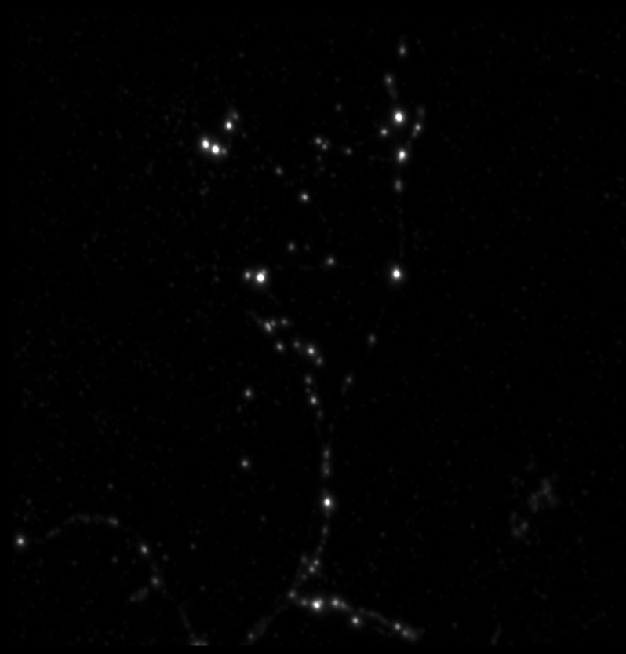
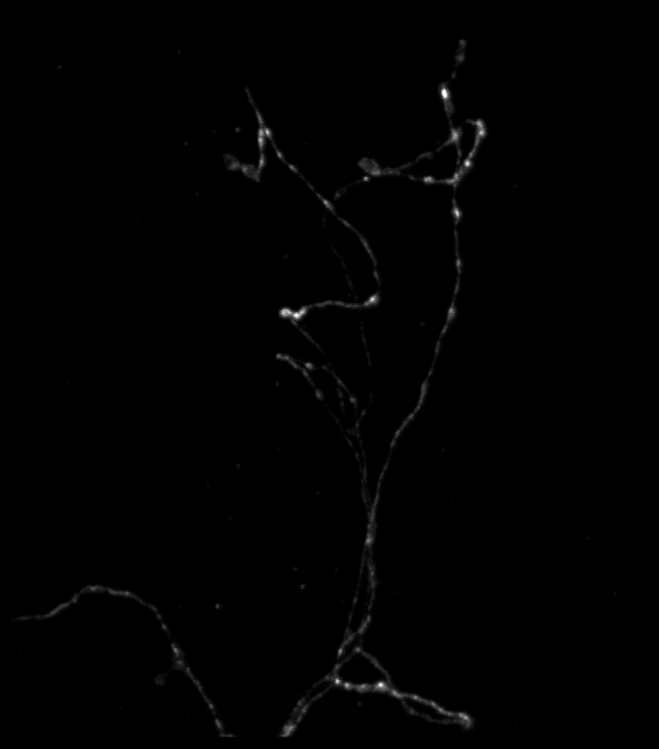
0H 3

